Slide 1
Crustal thermal processes &
Low-T thermochronology in Fennoscandia
Ilmo Kukkonen
Lecture on the
Short course on low temperature thermochronology
University of Helsinki
Oct 23 – 27, 2017

Slide 2
Crustal thermal processes – Quick overview
Heat flow
Temperatures in crust
Sedimentation and erosion
Intrusions
Extension
Crustal thickening
Low-T thermochronology in Fennoscandia
Geological evolution in central Fennoscandia after the Svecofennian orogeny
Phanerozoic geological history of Fennoscandia
Sedimentary rocks on the peneplain in Fennoscandia
AFT, U-Th/He and Ar-Ar data and models by Murrell
AFT compilation in Fennoscandia by Hendriks et al.
Outokumpu deep drill hole data
Eridanos river system and late erosion

Slide 3
Heat flow from inside the Earth
Heat flow is determined with Fourier’s first law of heat conduction
In words the above equation tells that
Heat flow = Thermal conductivity × Temperature gradient
The common unit applied for heat flow is mW m⁻²

Slide 4
Conductive temperatures in the crust are calculated by solving Fourier’s second law of heat conduction with appropriate boundary conditions
F-2 in 1D
T is temperature
t is time
A is heat generation rate (W m⁻³)
λ is thermal conductivity which expresses the ability of matter to conduct heat energy (unit Wm⁻¹K⁻¹),
c is specific heat capacity (unit J kg⁻¹K⁻¹) which expresses the ability of matter to store heat
s is diffusivity (unit m²s⁻¹) expresses the ability of matter to react for temperature changes

Slide 5
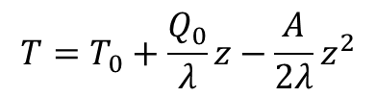
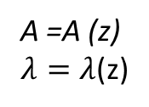
Calculation of crustal temperatures (geotherms)
Alternative 1: Starting from surface heat flow Q₀
Q₀, T₀
T
$$T=T_{0}+\frac{Q_{0}}{λ}z−\frac{A}{2λ}z^{2}$$
Crust
A =A (z)
$λ=λ$(z)
Moho
z =d
z
Mantle

Slide 6
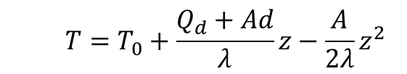
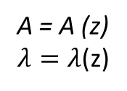
Calculation of crustal temperatures (geotherms) (cont.)
Alternative 2: Starting from mantle heat flow
T₀
T
$$T=T_{0}+\frac{Q_{d}+Ad}{λ}z−\frac{A}{2λ}z^{2}$$
Crust
A = A (z)
$λ=λ$(z)
Moho
z =d
Q_{d}
z
Mantle

Slide 7
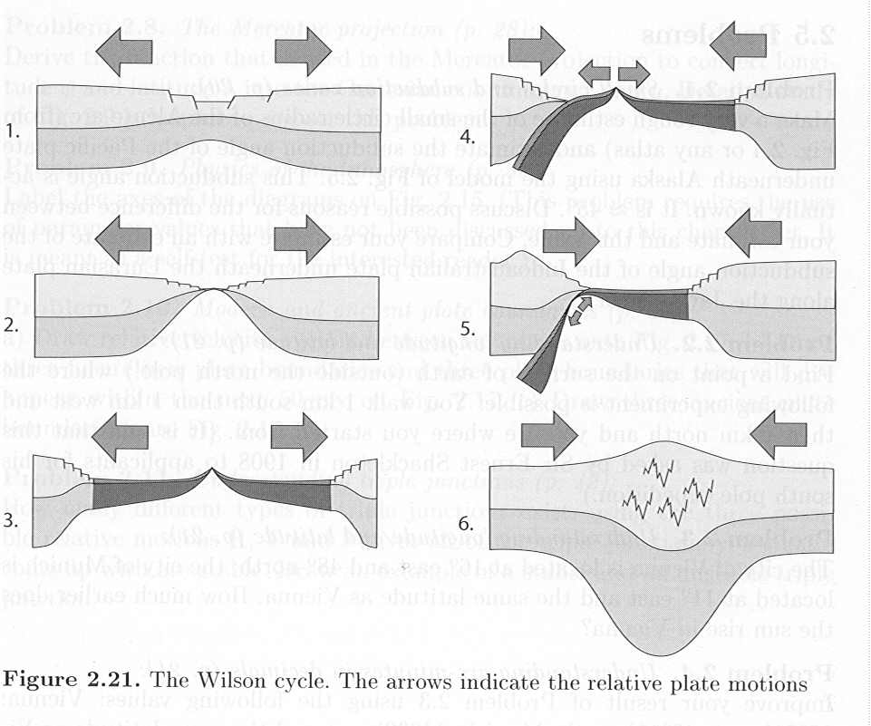
Tectonic phases of the Wilson cycle
Subduction of an oceanic plate
Subduction of a ridge
Closure of basin
Collision
Extension
Opening of
sea basin
Production of oceanic crust in the mid-oceanic ridge
Stüwe 2002

Slide 8
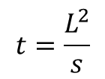
Duration of conductive thermal disturbances in the lithosphere
$$t=\frac{L^{2}}{s}$$
(10.1)
where
t is the thermal time constant of the lithosphere after which time the disturbances have vanished,
L is lithosphere thickness and
s is diffusivity
Examples
Thick lithosphere :
L = 150 km, a = 1 10⁻⁶ m²s⁻¹, t = 710 ·10⁶ a
Thin lithosphere
L = 50 km, a = 1 10⁻⁶ m²s⁻¹, t = 80 ·10⁶ a

Slide 9
Heat sources in different tectonic processes of the crust
Heat source/mechanism Importance Characteristic parameter
of heat transfer
Conduction Big Characteristic time
τ = L² / s
Advection
Fluid flow small Peclet number
Magma Pe = uL / s (Pe >1)
-Intrusions Big (locally)
- underplating Big (locally)
Erosion, exhumation Big
Heat production
Radioactive Big
Chemical
-latent heat Big (locally) S × t
-reactions Short-lived, (S is heat production)
local
Modified from Stüwe 2002

Slide 10
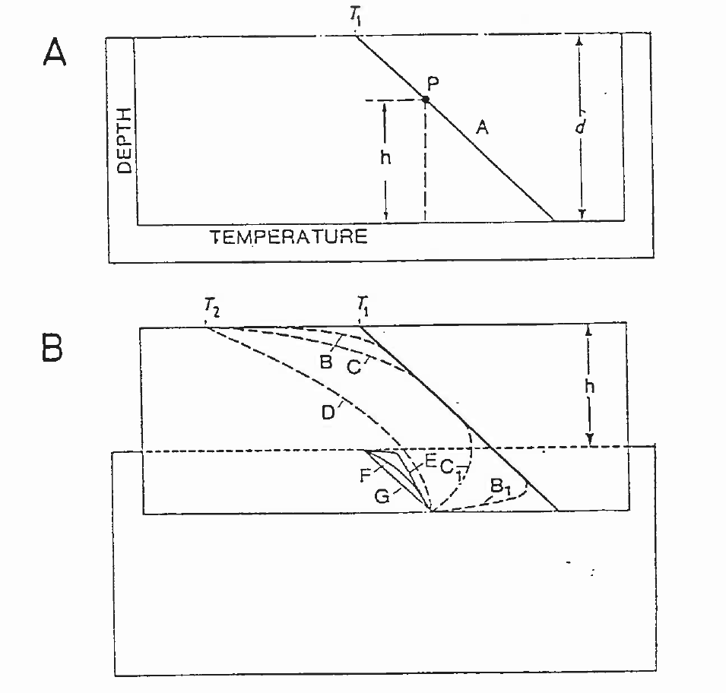
Effect of erosion, sedimentation and uplift
Effect of uplift and erosion on geotherms
Steady-state temperature profile
Sudden Uplift of block
New T-z curves B, C, D and B₁, C₁
Sudden erosion back to original level
New T-z curves F, G

Slide 11

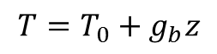
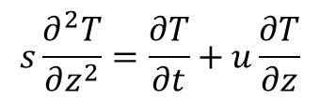
The thermal effect of sedimentation and erosion are analogous to convective heat transfer problems
Moving bedrock transports heat with itself
Heat conduction equation in 1D:
$$s\frac{∂^{2}T}{∂z^{2}}=\frac{∂T}{∂t}+u\frac{∂T}{∂z}$$
(10.2)
where
s is diffusivity and
$u$ is the velocity of the medium relative to the boundary surface
(if z is positive downward, positive velocity is for sedimentation and negative for erosion)
$$T=T_{0}+g_{b}z$$
when t = 0
(10.3)
and when t > 0, the surface temperature is

Slide 12
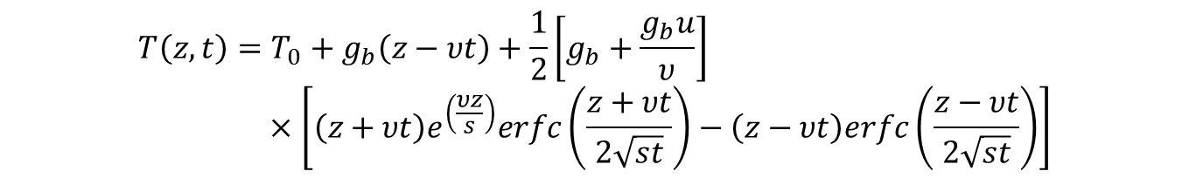
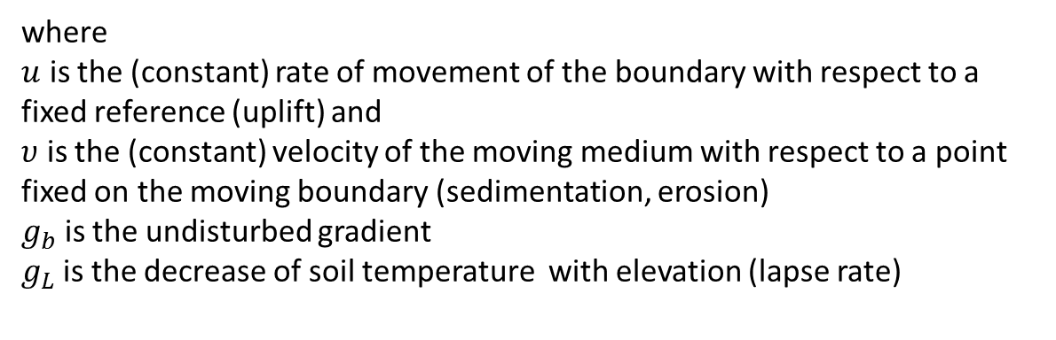
The solution from Carslaw and Jaeger (1959) and repeated by Powell et al. (1988) is:
$$T\left(z,t\right)=T_{0}+g_{b}\left(z−υt\right)+\frac{1}{2}\left[g_{b}+\frac{g_{b}u}{υ}\right]×\left[\left(z+υt\right)e^{\left(\frac{υz}{s}\right)}erfc\left(\frac{z+υt}{2\sqrt{st}}\right)−\left(z−υt\right)erfc\left(\frac{z−υt}{2\sqrt{st}}\right)\right]$$
(10.4)
where
$u$ is the (constant) rate of movement of the boundary with respect to a fixed reference (uplift) and
$υ$ is the (constant) velocity of the moving medium with respect to a point fixed on the moving boundary (sedimentation, erosion)
$g_{b}$ is the undisturbed gradient
$g_{L}$is the decrease of soil temperature with elevation (lapse rate)

Slide 13
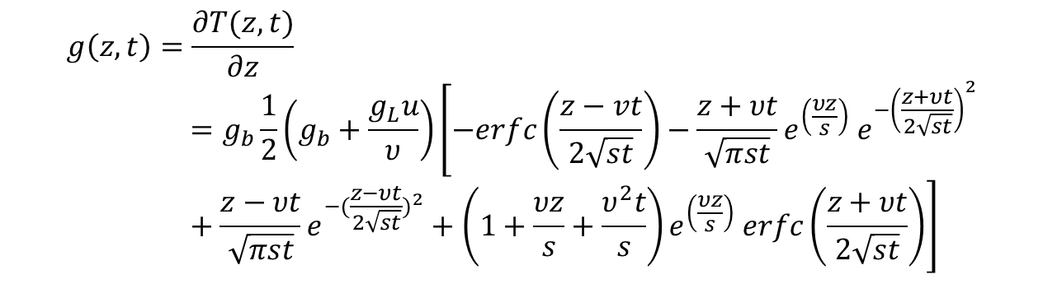
The corresponding effect on temperature gradient is obtained from:
$$g\left(z,t\right)=\frac{∂T(z,t)}{∂z}=g_{b}\frac{1}{2}\left(g_{b}+\frac{g_{L}u}{υ}\right)\left[−erfc\left(\frac{z−vt}{2\sqrt{st}}\right)−\frac{z+υt}{\sqrt{πst}}e^{\left(\frac{υz}{s}\right)} e^{−{\left(\frac{z+υt}{2\sqrt{st}}\right)}^{2}}+\frac{z−υt}{\sqrt{πst}}e^{−({\frac{z−υt}{2\sqrt{st}})}^{2}}+\left(1+\frac{υz}{s}+\frac{υ^{2}t}{s}\right)e^{\left(\frac{υz}{s}\right)} erfc\left(\frac{z+υt}{2\sqrt{st}}\right)\right]$$
(10.5)
Some results for erosion and sedimentation are shown in the next two slides

Slide 14
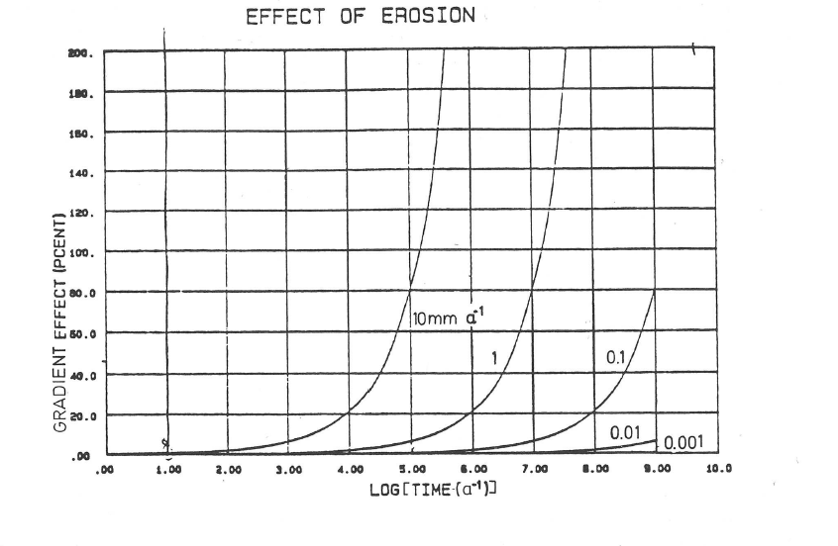
Effect of erosion on gradient at the earth’s surface
E.g., erosion rate of the Svecofennian mountains (roots presently in southern Finland) was about 0.15 - 0.37 mm/a during 1.84-1.82 Ga
The erosion rate of mountains decays appr. exponentially with time
In a system eroding rapidly the surface heat flow is markedly disturbed after times of about 10 - 100 Ma of steady erosion
u = 0 (no uplift)
s = 1 × 10⁻⁶ m² s⁻¹
Gradient effect (%)
Erosion rate
Powell et al. 1988
Log (time [a⁻¹])

Slide 15
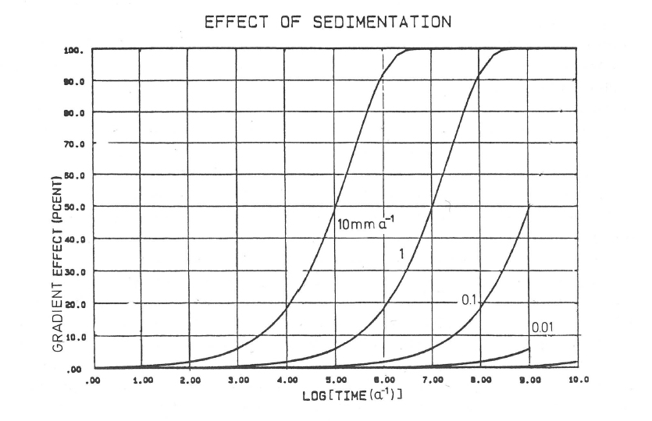
Effect of sedimentation on gradient at earth’s surface
Typical rates of sedimentation are 1 - 0.1 mm a⁻¹
The surface heat flow is markedly (>20%) affected only after 1- 100 Ma
u = 0 (no uplift)
s = 1 × 10⁻⁶ m² s⁻¹
Sedimentation rate
Gradient effect (%)
Log (time [a⁻¹])
Powell et al. 1988

Slide 16
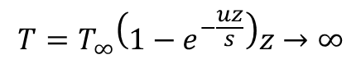
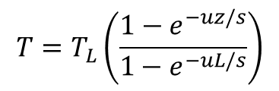
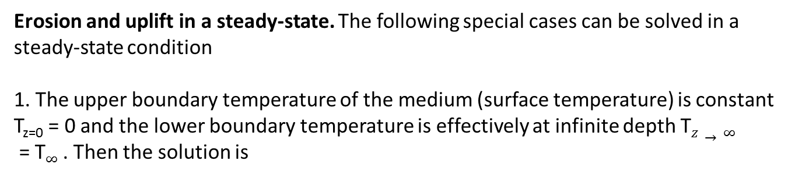
Erosion and uplift in a steady-state. The following special cases can be solved in a steady-state condition
1. The upper boundary temperature of the medium (surface temperature) is constant T_{z=0} = 0 and the lower boundary temperature is effectively at infinite depth T$z→∞$
= T$∞$ . Then the solution is
$$T=T_{∞}\left(1−e^{−\frac{uz}{s}}\right)z→∞$$
(10.6)
2. Upper boundary temperature is constant T_{z=0} = 0 and lower boundary is at depth z = L (eg., Moho or lithosphere/asthenosphere boundary) is T = T_{L} . Then the solution is
$$T=T_{L}\left(\frac{1−e^{−uz/s}}{1−e^{−uL/s}}\right)$$
(10.7)
In the figure (next page) the results of these special cases are shown.

Slide 17
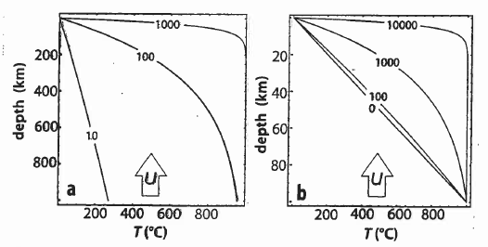
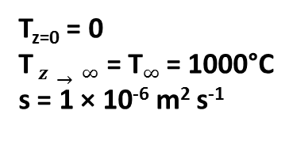
Effect of erosion in steady-state conditions
T_{z=0} = 0
T$z→∞$= T$∞$ = 1000°C
s = 1 × 10⁻⁶ m² s⁻¹
T_{z=0} = 0
T = T_{L} = 1000°C
L = 100 km
s = 1 × 10⁻⁶ m² s⁻¹
Contours: advection (erosion) rates in m/Ma
Stüwe 2002

Slide 18
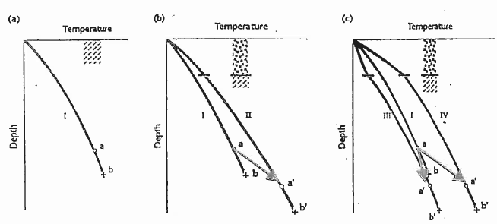
Effect of sedimentary cover on temperature (schematically)
Comparison geotherm: Conditions before sedimentation
Sediment conductivity and heat production are the equal with the basement
Effect of thermal conductivity of sediment: curve IV: low conductivity, III: high conductivity
a, b: original z-T conditions, a’, b’: new equilibrium conditions after sedimentation
Chapman and Furlong 1992

Slide 19
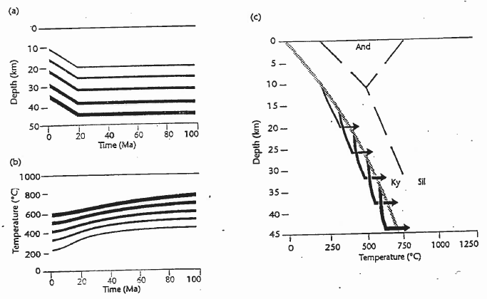
Effect of sedimentation when time is taken into account
10 km of sedimentation and subsidence during 20 Ma
Thicknesss of arrows corresponds to the line thicknesses in panels in a and b
Depth (km)
Initial geotherm:
Q₀ = 65 mWm⁻²
λ_{bas} = λ_{sed} = 2.6 Wm⁻¹K⁻¹
A_{sed} = 1μWm⁻³
Depth (km)
Temperature (°C)
Temperature (°C)
Time (Ma)
Chapman and Furlong 1992

Slide 20
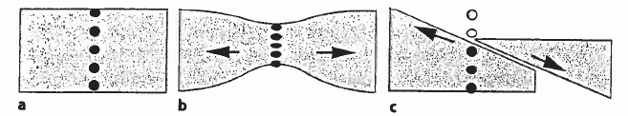
Extension: ”Pure shear” and ”simple shear”
Extension is one of the fundamental tectonic processes leading to formation of sedimentary basins and breaking up of continents
Pure shear (b): Lithosphere thins by extension
After extension mid-crustal rocks do not outcrop at erosion level
Sedimentation covers the extended part
Simple shear (c): Lithosphere thins by shearing (along a low-angle normal fault)
Due to uplift high-grade rocks are exhumed to surface level
Sedimentation
Sedimentation
Initial lithosphere
Pure shear
Simple shear

Slide 21
MacKenzie-type extension models
Extension is by pure shear in MacKenzie models
Extension is assumed to take place much faster than the thermal relaxation time of the lithosphere (t = L²/a) (In the model extension takes place instantaneously)
The extended part of lithosphere extends by a factor β
Typically in intracontinental basins β is about 1-2
In continental margin basins β ranges fom about 1 on continental slopes onshore to 4…5 offshore
The MacKenzie model (1978) has been widely used due to its simplicity, and there are many refinements of it in the subsequent literature
Presently extension modeling is most often done with numerical models

Slide 22
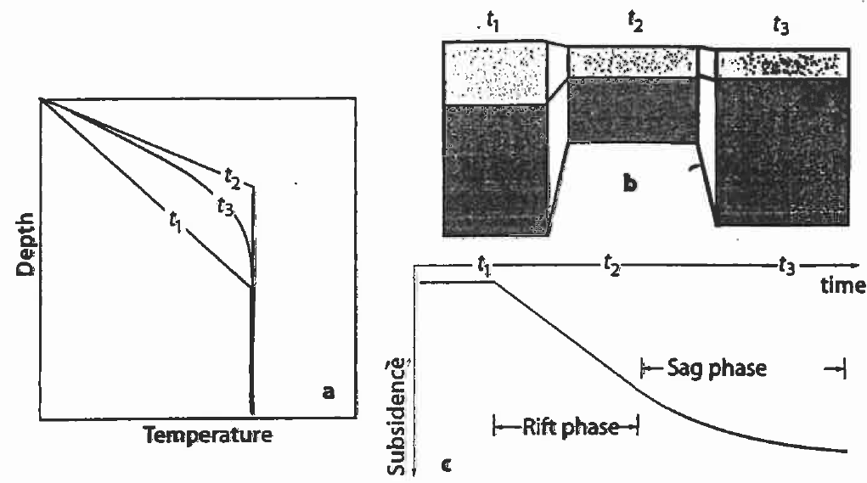
Principles of the MacKenzie model
Prior to onset of extension (t₁)
At the end of the stretching phase (t₂)
During subsequent thermal equilibration of the lithosphere (t₃)
Crust
Mantle
Stüwe 2002

Slide 23
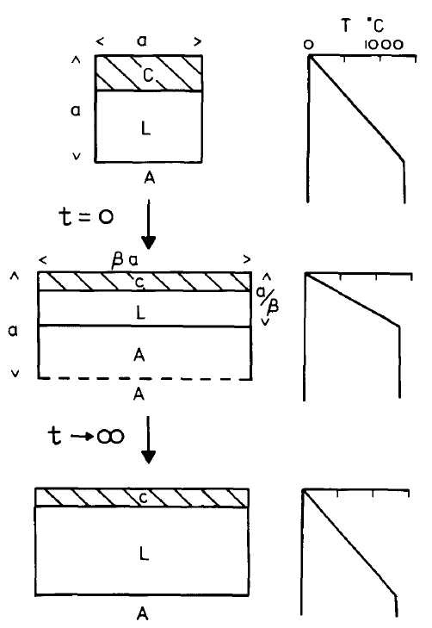
Phases of the MacKenzie extension model
Initial equilibrium lithosphere
Heat production is neglected in the model
Crust and mantle have equal conductivities
Instantaneous extension by factor β
Increase of geothermal gradient by factor β
Upwelling of astenospheric material
Cooling and re-thickening of the lithosphere
Thicknening of the mantle part relases a transient pulse of heat
With long times, lithosphere equilibrates again
MacKenzie 1978

Slide 24
Temperature of the lithosphere before extension :
And after extension :
where
T₀ is surface temperature,
T_{L} is the temperature at the lower boundary of the lithosphere (astenosphere temperature),
L is the thickness of the lithosphere before extension
β is the extension factor.
We assume for simplicity that T₀ = 0, then the temperature after extension is
(10.8)
(10.9)
(10.10)

Slide 25
Aftwer extension the geotherm finds a new equilibrium and heat is released due to re-thicknening of the lithospheric mantle:
[J m⁻²]
Extension produces a transient increase in heat flow.
The temperature of the lithosphere after the extension can be obtained with the transient solution of a 1-dimensional layer (Carslaw and Jaeger, 1959):
where s is diffusivity and the factors a_{n} are
(10.11)
(10.12)
(10.13)

Slide 26
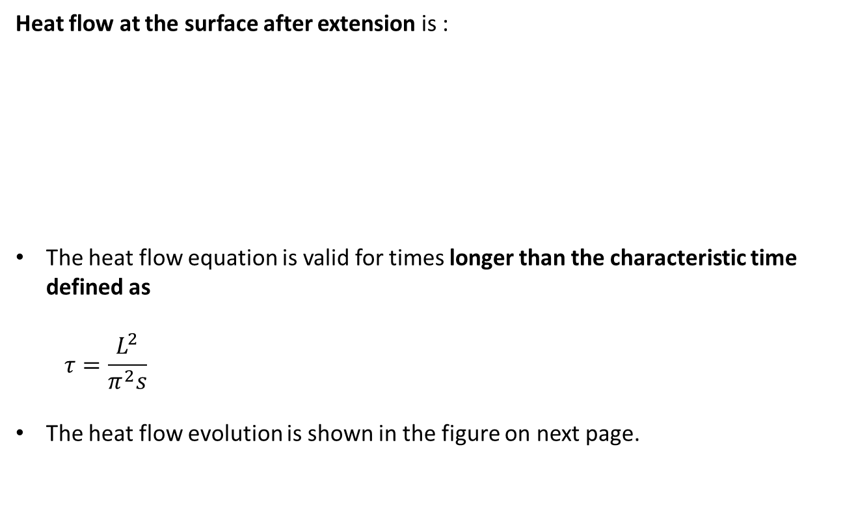
Heat flow at the surface after extension is :
The heat flow equation is valid for times longer than the characteristic time defined as
$$τ=\frac{L^{2}}{π^{2}s}$$
The heat flow evolution is shown in the figure on next page.
(10.14)
(10.15)

Slide 27
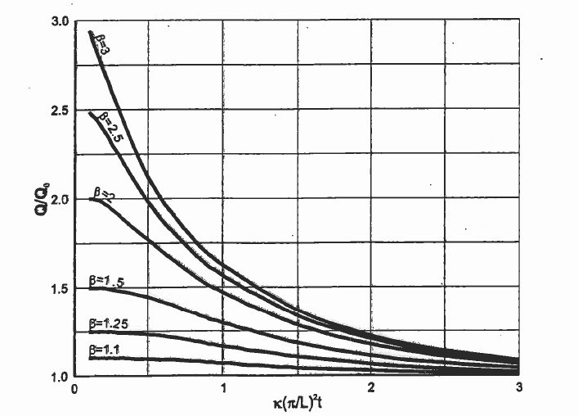
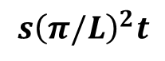
Change of heat flow due to extension
Q/Q₀
Q₀= heat flow before extension
β is extension factor
Heat flow increases at maximum by factor β
Parameters of dimensionless time:
L is thickness of lithosphere before extension
s is diffusivity
t is time
$$s{\left(π/L\right)}^{2}t$$
Time needed for the heat flow signal to penetrate the crust
Dimensionless time
Beardsmore and Cull 2001

Slide 28
The thinning of lithosphere due to extension produces
isostatic subsidence of lithosphere (S_{i})
uplift of astenosphere.
The amount of subsidence depends on the amount of stretching, initial crustal thickness (t_{c}) and lithosphere thickness (L) and the densities of crust, lithospheric mantle and astenosphere.
The densities are affected by thermal contraction and expansion
The isostatic subsidence (S_{i}) is obtained from
(10.16)
where
ρ_{a} = ρ_{m0}[1-αT₁] = density of the asthenophere
ρ_{m} = ρ_{m0}[1- α(T₀ + 0.5 (T_{L} - T₀)(1 + t_{c}/L) = density of the lithospheric mantle
ρ_{c} = ρ_{c0}[1- α(T₀ + 0.5 (T_{L} - T₀)(t_{c}/L) = density of crust
ρ_{w} = density of water filling the extension basin
T₀ = surface temperature
α = thermal expansion coefficient of rock
ρ_{m0 ja} ρ_{c0} are the densities of mantle and crust at reference temperature (0°C)

Slide 29
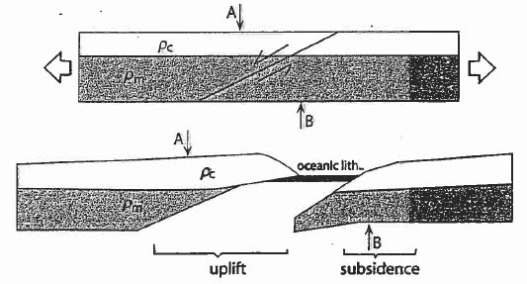
Extension by normal faulting (simple shear)
Low-angle normal fault intersects the whole lithosphere
Development of passive continental margins
At location A extension decreased the thickness of the mantle part of lithosphere
At B extension decreased the thickness of the crust
As a result there is isostatic uplift the of the passive margin of A and subsidence at B
Stüwe 2002

Slide 30
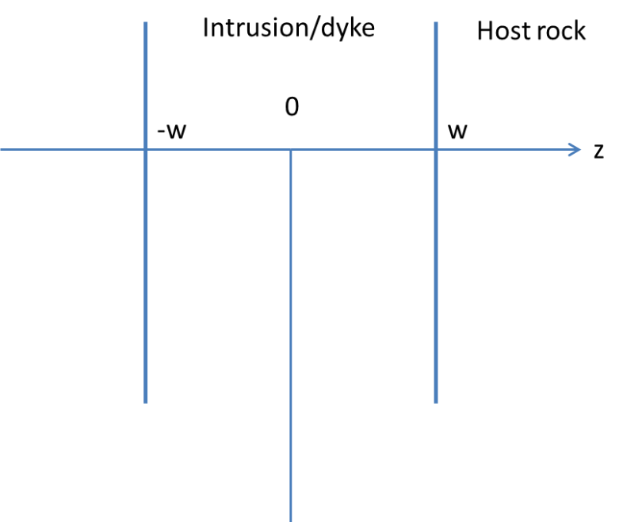
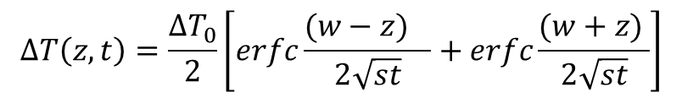
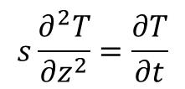
Thermal effects of a plate-form intrusion
We assume the intrusion to be an infinitely long plate (a sill or dyke) located at a sufficiently long distance from the surface (full-space medium)
Heat conduction equation without heat production :
$$s\frac{∂^{2}T}{∂z^{2}}=\frac{∂T}{∂t}$$
(10.17)
Intrusion is located at –w ≤ z ≤ +w.
Boundary condition of the initial state :
T = T₀, when t = 0, –w ≤ z ≤ +w
T = T, when t = 0, │x│> w
∆T₀ =T₀ – T, kun t = 0
The solution is once again provided by Carslaw and Jaeger (1959)
(10.18)
$$ΔT\left(z,t\right)=\frac{ΔT_{0}}{2}\left[erfc\frac{(w−{z)}_{}}{2\sqrt{st}}+erfc\frac{(w+z) }{2\sqrt{st}}\right]$$
(10.19)

Slide 31
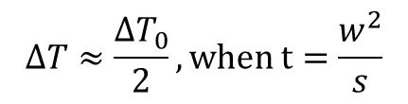
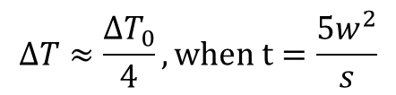
Example of a cooling dyke.
The dyke is 2 m thick, w = 1 m, T₀ = 1000 °C, T = 0, s = 1·10⁻⁶ m²s⁻¹ .
Temperatures at the centre of the dyke :
T (0, 1 week) = 640°C
T (0, 1 month) = 340°C
T (0, 1 year) = 100°C
→dykes cool very rapidly!
There are rules of thumb for the temperature at the center of the dyke :
$$ΔT≈\frac{ΔT_{0}}{2}, when t=\frac{w^{2}}{s}$$
(10.20)
$$ΔT≈\frac{ΔT_{0}}{4}, when t=\frac{5w^{2}}{s}$$
(10.21)

Slide 32
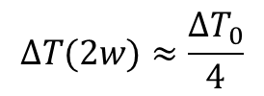
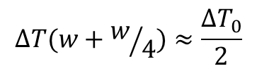
For the area outside the dyke there are the following approximations :
Temperature maximum reached at 2w:
Temperature maximum reached at w+/4:
$$ΔT(2w)≈\frac{ΔT_{0}}{4}$$
(10.22)
$$ΔT(w+w/4)≈\frac{ΔT_{0}}{2}$$
(10.23)

Slide 33
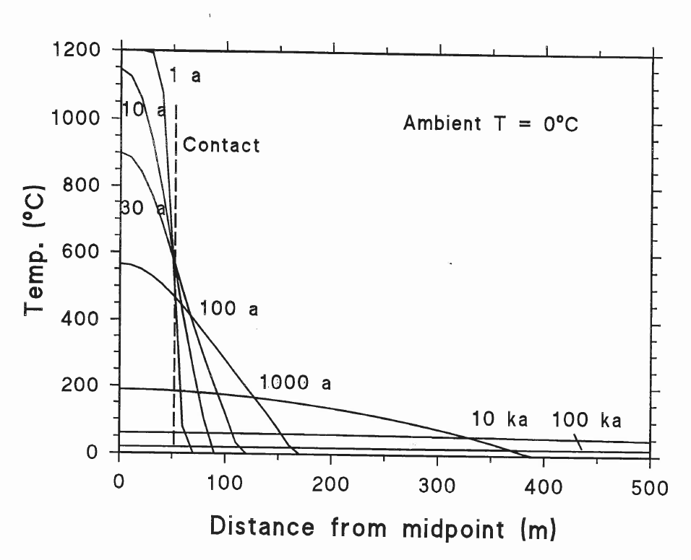
Cooling of a dyke near surface

Slide 34
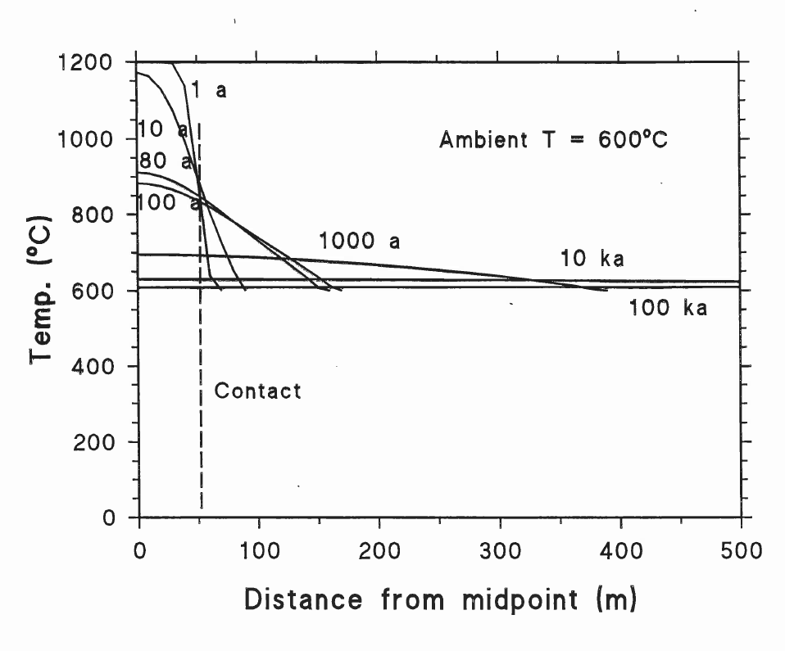
Cooling of a dyke in lower crust

Slide 35
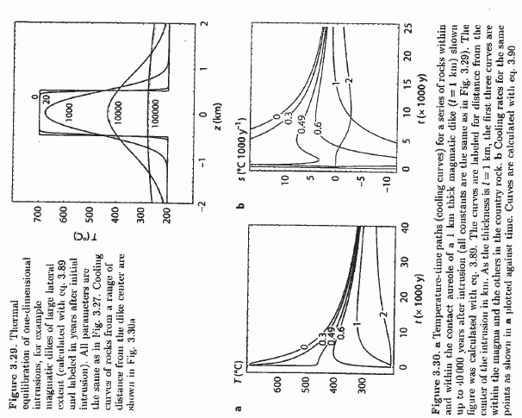
Examples of models of cooling intrusions
Stüwe 2002
1 km thick intrusion (layer) :
Cooling time in years
Conductive model
Calculated from the dyke model
Host rock temperature and cooling rate
Curve parameters: distance in km from center of intrustion

Slide 36
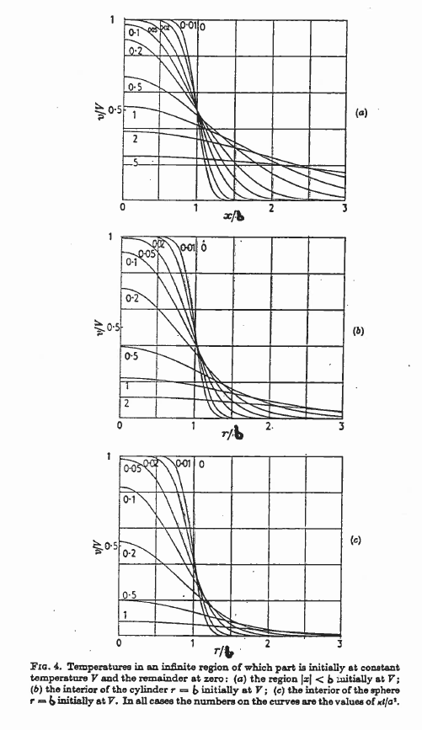
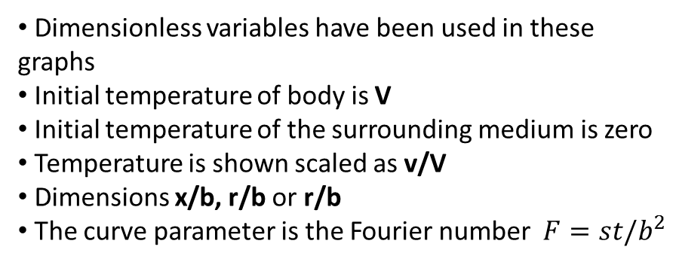
Cooling of a plate, cylinder and sphere
Dimensionless variables have been used in these graphs
Initial temperature of body is V
Initial temperature of the surrounding medium is zero
Temperature is shown scaled as v/V
Dimensions x/b, r/b or r/b
The curve parameter is the Fourier number$F=st/b^{2}$
v/V
Infinite plate
Thickness 2b
x/b
v/V
v/V
Sphere
Radius b
Infinitely long cylinder
Radius b
r/b
r/b
Carslaw and Jaeger, 1959

Slide 37
In the C & J figure (plate-cylinder-sphere) the curve parameter is the Fourier number
F = st/b²
where b is dyke thickness, radius of cylinder or radius of sphere
Example, let’s assume a dyke :
Thickness 2 km, initial temperature 1000 °C above host rock, s = 1·10⁻⁶ m²s⁻¹
The Curve’5’ corresponds to a time of about 160 000 years (dyke is quite cool already)
Note! On using conductive plate models in geological applications:
The requirement of the distance from surface means a (homogeneous) full-space medium
Moreover, the latent heat of melt has not been taken inot account
(10.23)

Slide 38
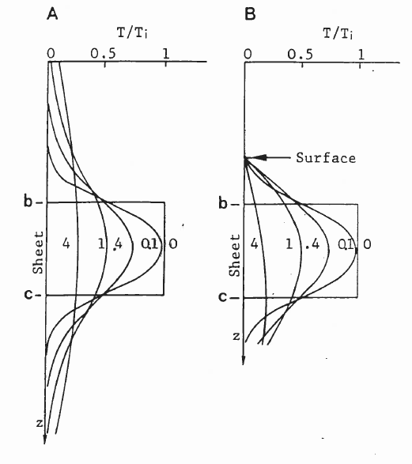
Cooling dyke: Difference between half-space and full-space media
A: dyke in full-space medium
B: dyke in half-space medium close to surface
Curve parameter is the Fourier number
The proximity of the surface kept at a constant temperature decreases the temperatures above the dyke and modifies them inside the dyke

Slide 39
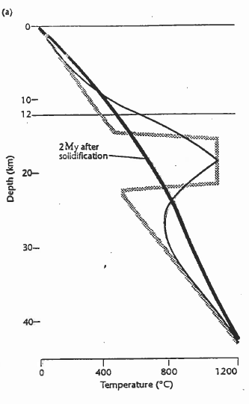
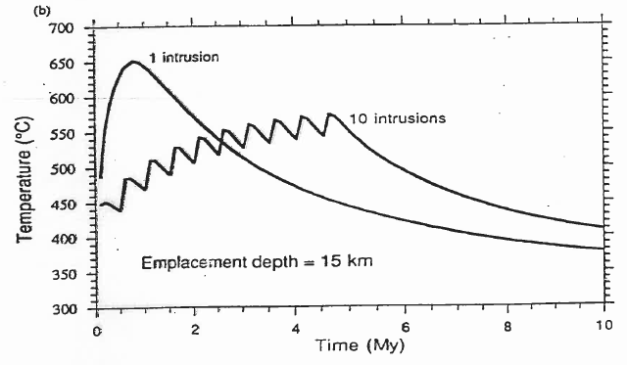
Numerical modeling of thermal effect of intrusions
7.5 km thick sill intrudes at 15 km depth
Temperature at 12 km, sill is formed with one intrusion pulse of magma, or in 10 pulses
Chapman and Furlong 1992

Slide 40
Paleoclimatic effects on subsurface temperatures
Variations in ground surface temperature diffuse downward and attenuate in amplitude
Temperatures are transient and do not represent steady-state conditions
Cooling
Warming
T₀
Temperature
After climatic cooling
After climatic warming
Steady-state conditions
Depth

Slide 41
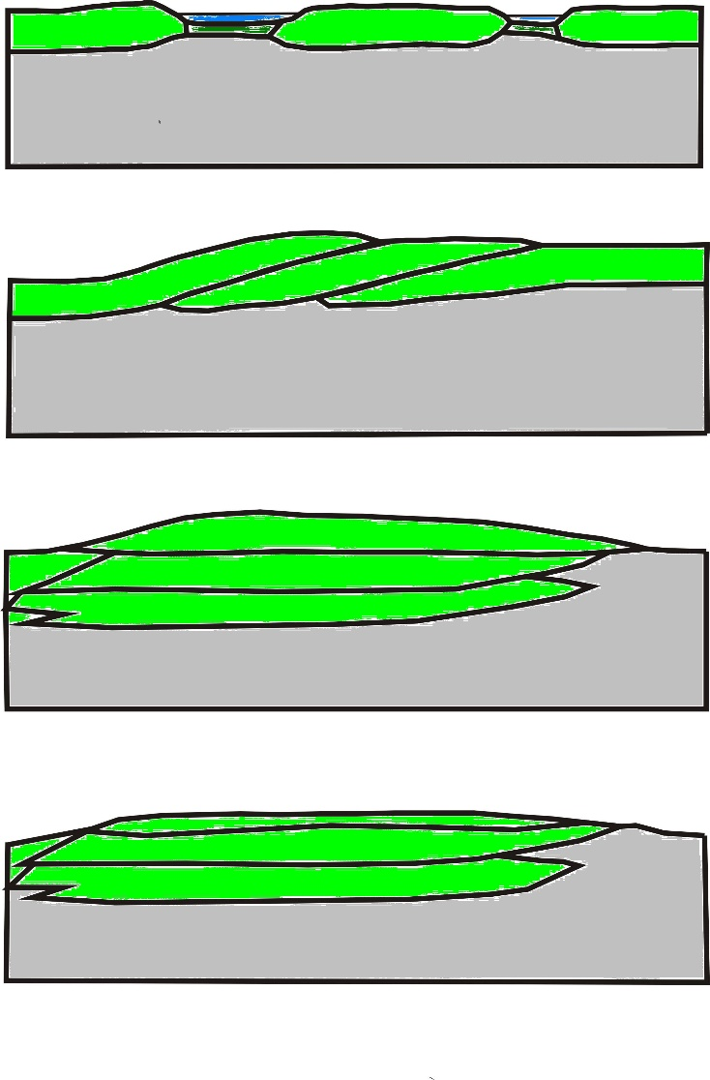
Building mountains by collision and imbricating crustal blocks
Before collision
Collision and thrusting
< 10-25 Ma
Thickened crust;
heating of stack, uplift erosion begins
Partial melting in middle/lower crust
10-50 Ma
Uplift, continued erosion, cooling
50-300 Ma

Slide 42
Principles of conductive thermal modelling of crustal stacking
Crust 1
Crust 2
T
Situation
before collision
Mantle
Mantle
Geotherm
Z
Crust 1
Crust 2
Collision and stacking
T
Crust 1
Stack
t = 0 Ma
Crust 2
Geotherm
Mantle
Z

Slide 43
Temperature effects of crustal thickening
Temperature-depth-time plot
Initial situation
t₀ initial geotherm at time of collision
t_{0,} ,t₁ ,t₂ ,t₃ ,t₄ geotherms at later times
Before
After collision

Slide 44
Low-T thermochronology in Fennoscandia
Thermochrometers in general
Mesoproterozoic - Phanerozoic geological history of Fennoscandia
Apatite fission track results in Fennoscandia
Geologically recent uplift and erosion – the Eridanos river system

Slide 45
Closure temperatures of common thermochronometers

Slide 46
Example: Applying several thermochronometers on a single sample from Swiss Alps

Slide 47
Geological evolution of Fennoscandia –
from Archaean to Phanerozoic
Rämö & Kohonen, 2005

Slide 48
Rämö & Kohonen, 2005

Slide 49
Mesoproterozoic to Cambrian sedimentary rocks and mafic dyke swarms
Rämö & Kohonen, 2005

Slide 52
Sedimentary cover in Estonia

Slide 53
Mesoproterozoic – Paleogene evolution (part 1)

Slide 54
Mesoroterozoic – Paleogene evolution (part 2)

Slide 55
Mesoroterozoic – Paleogene evolution (part 3)

Slide 56
Present day geology
Murrell and Andriessen, 2004

Slide 57
Murrell and Andriessen: Sample locations for AFT ages

Slide 58
Murrell and Andriessen: Summary of AFT ages
Enlarged on next page
Murrell and Andriessen, 2004

Slide 59
Murrell and Andriessen, 2004

Slide 60
Murrell 2001:
Ar-Ar
AFTT model ages
(U-Th)/He ages
Murrell, 2001

Slide 61
Distribution of AFT ages in Finland
Murrell, 2001

Slide 62
AFT ages in Fennoscandia
Hendriks et al., 2007

Slide 63
Time-temperature history model
Outokumpu 157 m AFTT model (Pecube)
Temperature
0
60
120
Time (Ma)
Andriessen and Kukkonen (unpublished)

Slide 64
Time-temperature history model
Outokumpu 1818 m AFTT model (Pecube)
Temperature
0
60
120
Time (Ma)
Andriessen and Kukkonen (unpublished)

Slide 65
North Sea and Fennoscandia:
The Eridanos fluvio-deltaic system
Erosion and transport from
Fennoscandia
Deposition in the North Sea Basin
< 10 Ma
Overeem et al. 2001

Slide 66
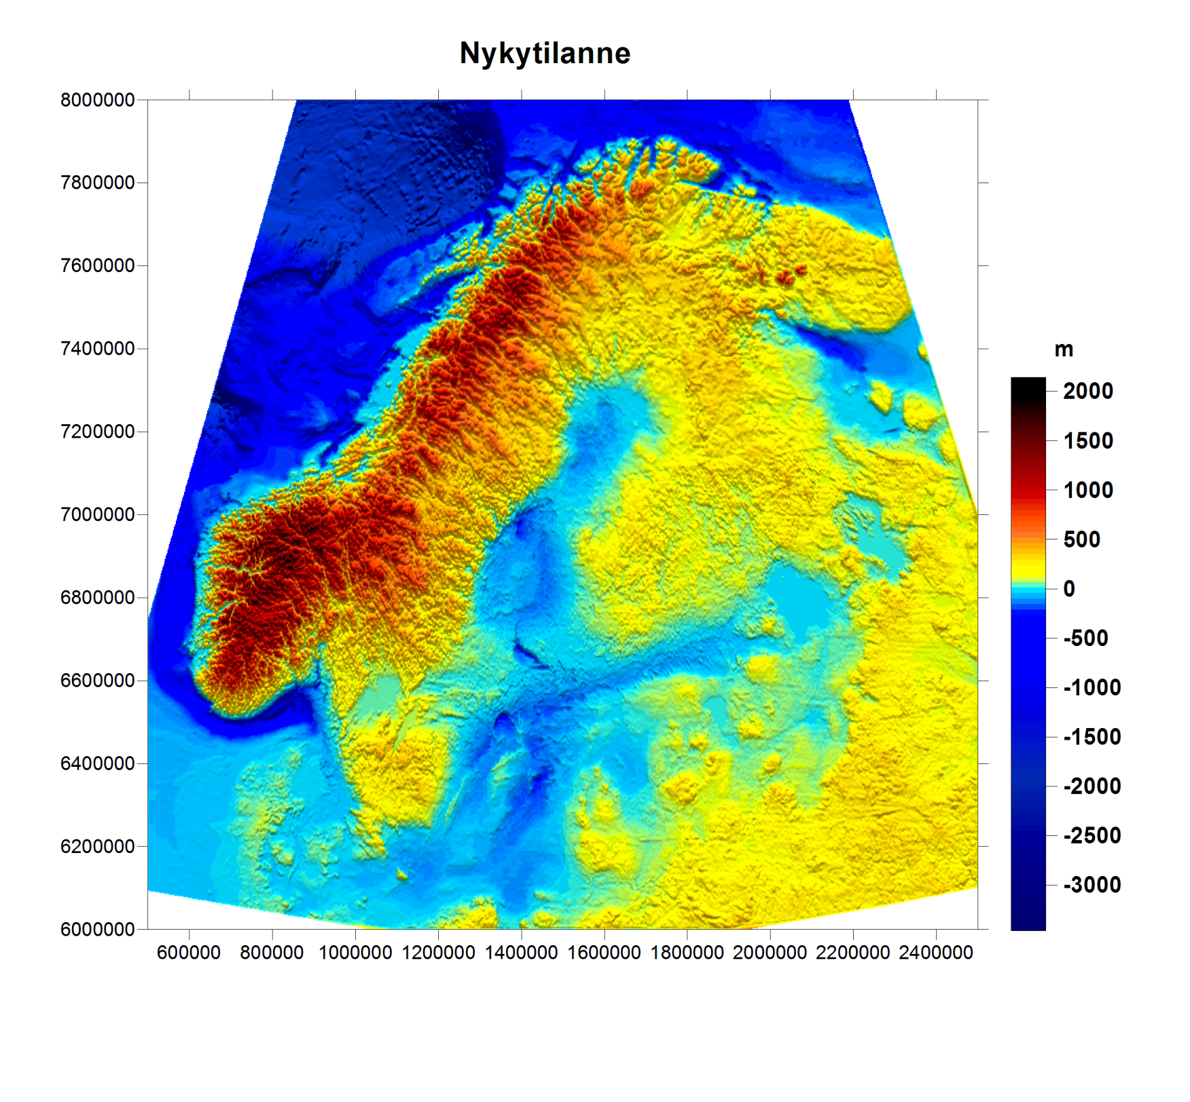
Present topography and bathymetry
Topographic and bathymetric data from IUGG Data Centre, Boulder (2 arc minute resolution)

Slide 67
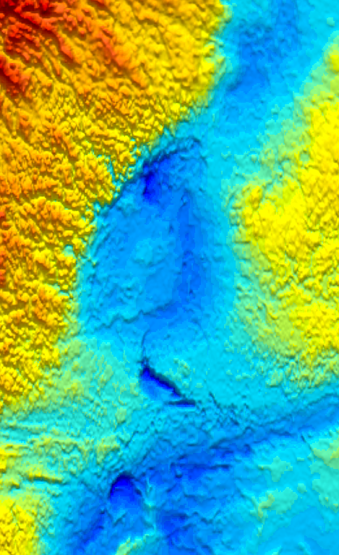
Present topography and bathymetry: Detail image

Slide 68
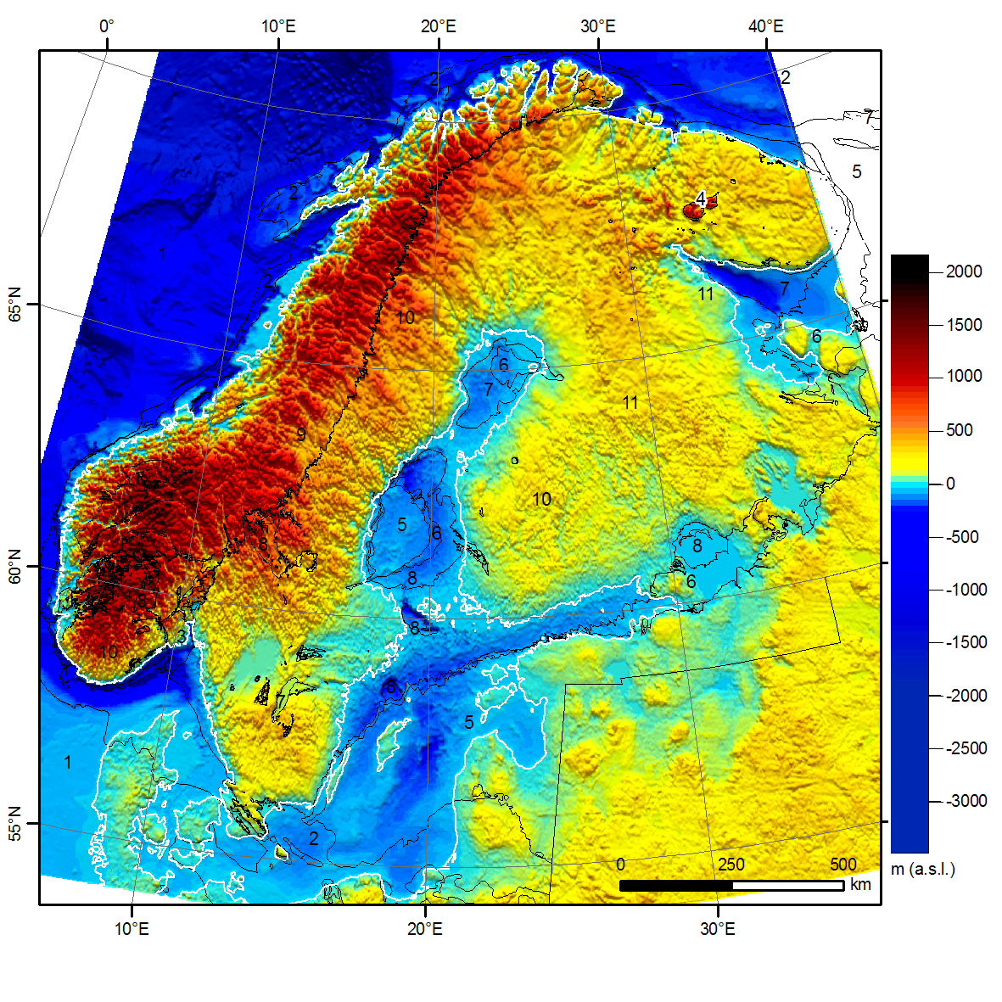
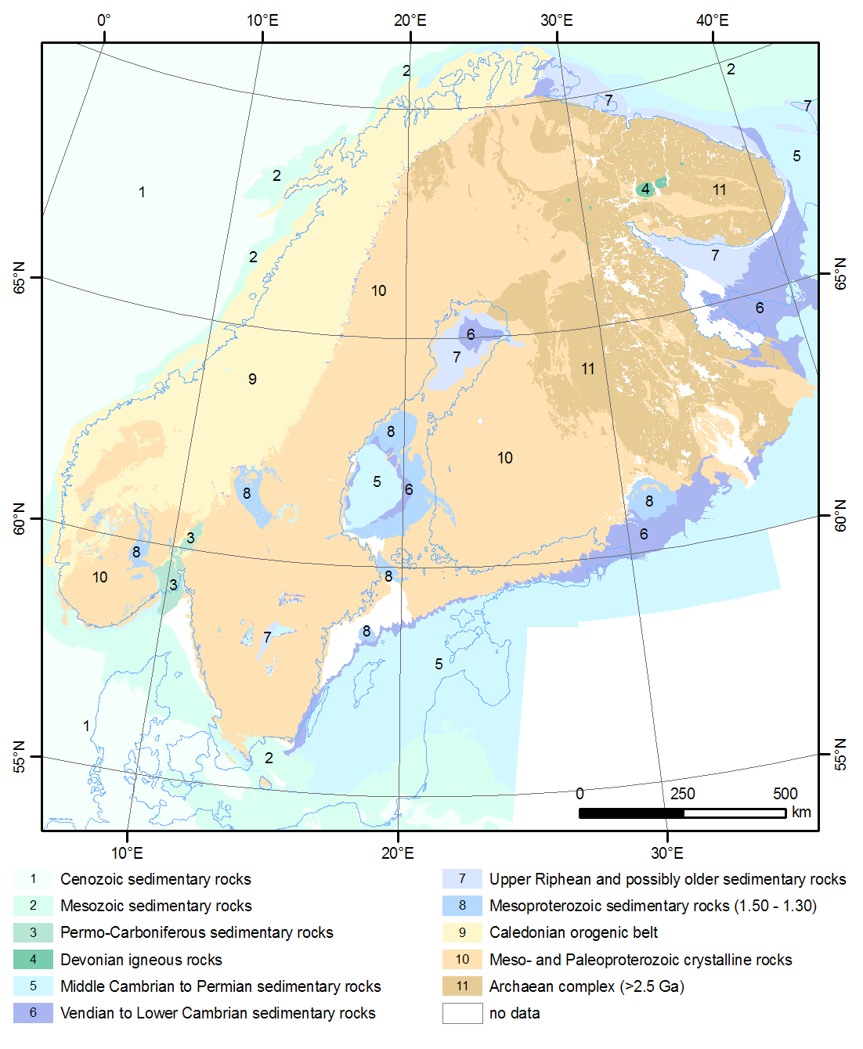
Present topography, bathymetry and major geological units
5 = Middle Cambrian to Permian
6 =Vendian to Lower Cambrian
7 = Upper Riphean
8 = Mesoproterozoic
Riphean: 1400 – 800 Ma; Mesoproterozoic: 1600 – 1000 Ma

Slide 69
Reminder: Geologigal time scale
Age in million of years (Ma)
Aikajaksojen suomenkieliset nimitykset
Eon: aioni, puolesta miljardista kahteen miljardia vuotta
Era: maailmankausi, yleensä satoja miljoonia vuosia
Period: kausi, yleensä alle sata miljoonaa vuotta
Epoch: epookki, yleensä kymmeniä miljoonia vuosia

Slide 70
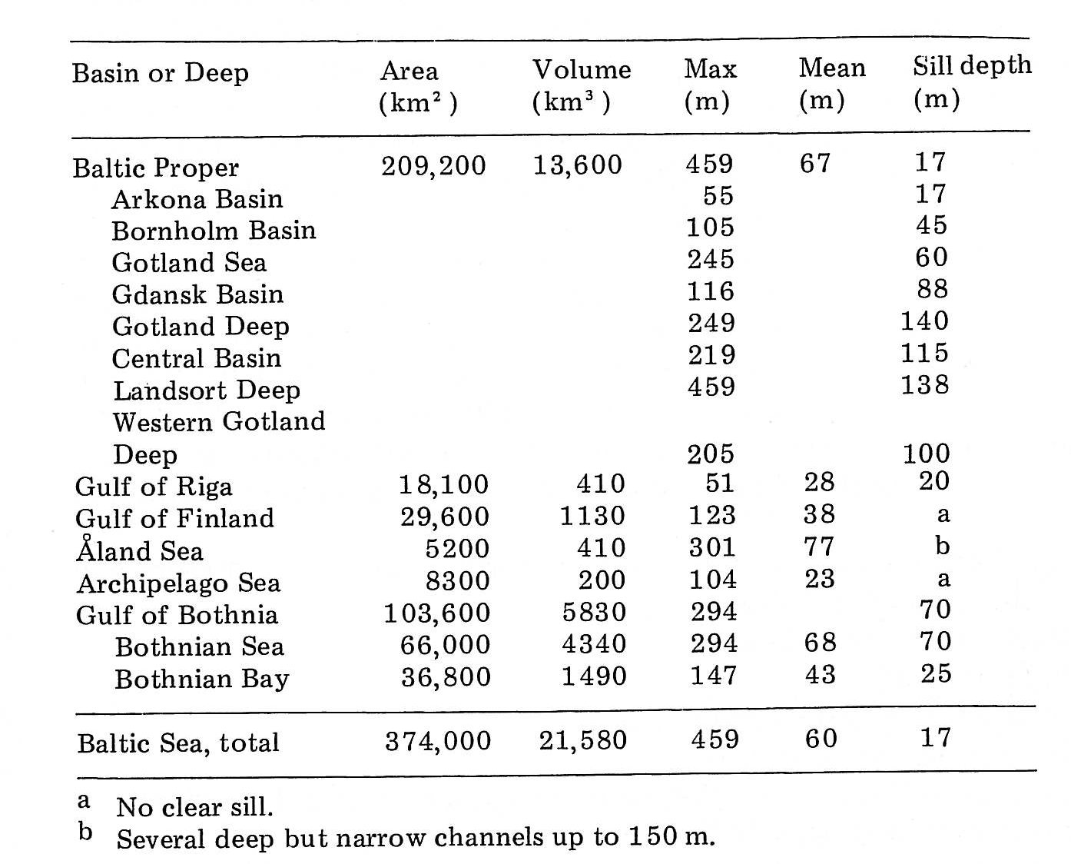
The Baltic Sea and subareas: areas, volumes and depths
Ignatius et al. (1981)

Slide 71
North Sea and Fennoscandia:
The Eridanos fluvio-deltaic system
Erosion and transport from
Fennoscandia
Deposition in the North Sea Basin
< 10 Ma
Overeem et al. 2001

Slide 72
Pliocene-Pleistocene sedimentation on the Eridanos delta
in the North Sea and Fennoscandian uplift
Overeem et al. 2001

Slide 73
Back-of-the-envelope calculation on erosion depths in the last 5 Ma
Average accumulation rate of sediments in the North Sea 10 × 10³ km³
Area of the Eridanos river system 1000 km x 200 km
→ about 250 m of rock has been removed
Average depth of the Baltic Sea and basins is 60 m
Deep basins 150 – 460 m
Thus, relatively recent uplift of Fennoscandia and erosion in the Eridanos system would explain the sedimentation rates and young-looking erosional features in the Baltic Sea

Slide 74
It would seem to me that there’s a lot of undiscovered issues in low-T thermochronology in Fennoscandia.
Thank you for your attention!

